Slide 1
Game of Sequencer
Multimedia Information Systems Final project report
M10609307

Slide 2
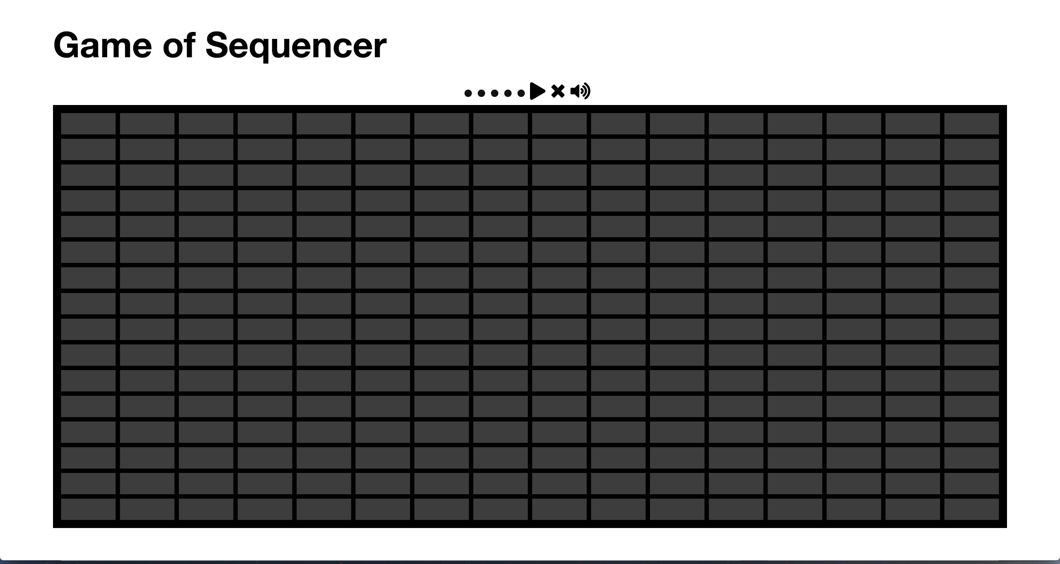
Game of Sequencer

Slide 3
Game of Sequencer
Mini project about music
melody automatic generator

Slide 4
Inspired by
step sequencer
Conway's Game of Life

Slide 5
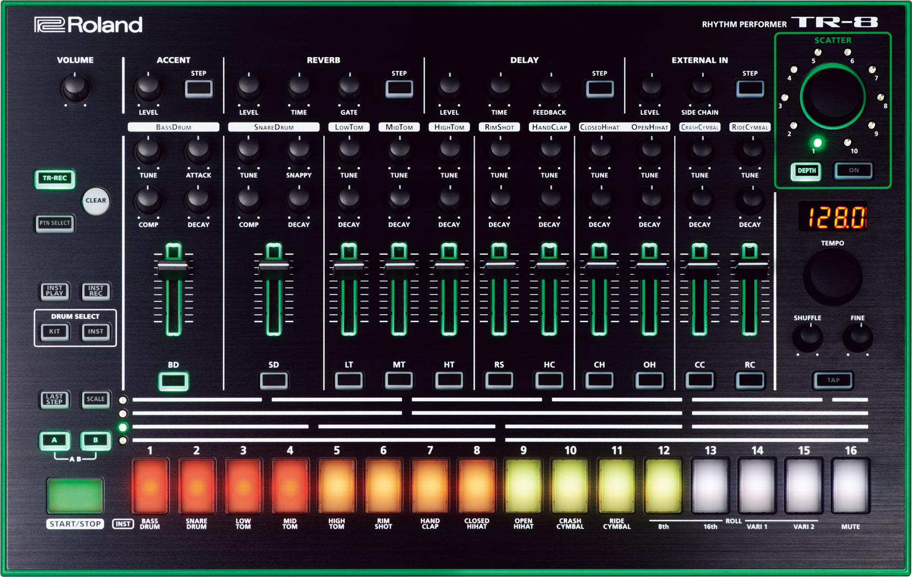
step sequencer
Notes:
Sequencer is a device or application software that can record, edit, or play back music,
notes are rounded into steps of equal time-intervals, and users can enter each musical note without exact timing

Slide 6
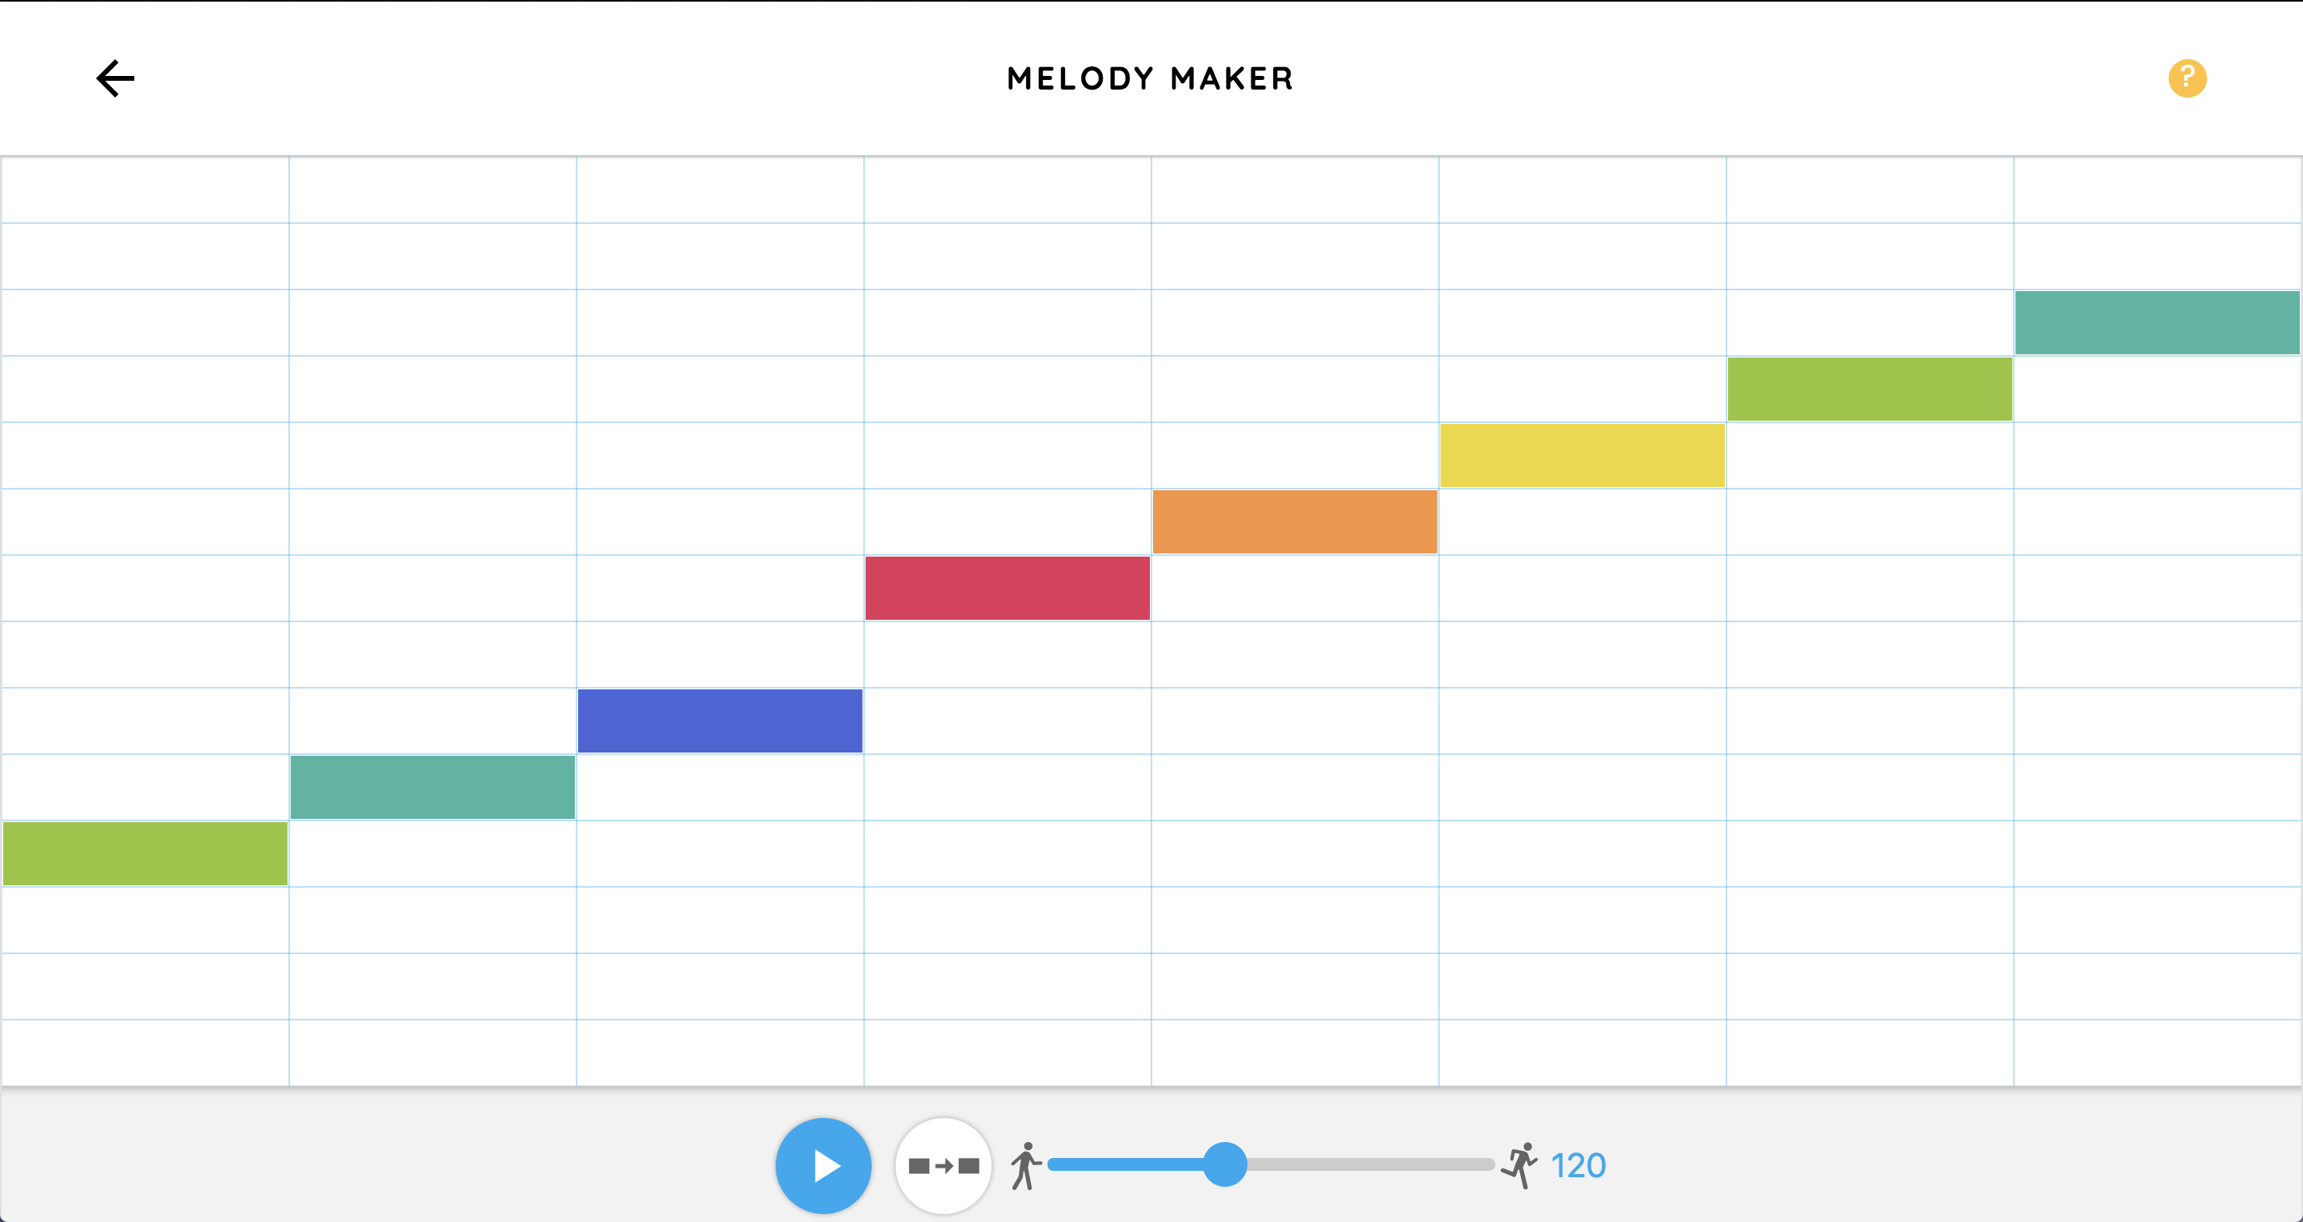
step sequencer
https://musiclab.chromeexperiments.com/Melody-Maker/
Notes:
This is a software setp sequencer made by google
horizon direction is time sequence
Vertical direction is notes indicate different pitchs

Slide 7
Game of Sequencer
melody automatic generator
NOT AI
Generate notes by rule
Rule in Conway's Game of Life

Slide 8
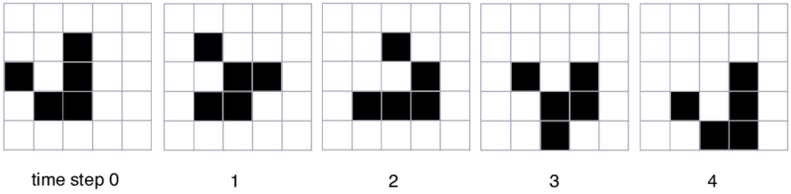
Conway's Game of Life
Notes:
devised by the British mathematician John Horton Conway in 1970
the game is a zero-player game, meaning that its evolution is determined by its initial state

Slide 9
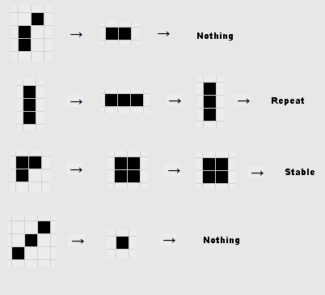
Conway's Game of Life
Any live cell with fewer than two live neighbors dies, as if by underpopulation.
Any live cell with two or three live neighbors lives on to the next generation.
Any live cell with more than three live neighbors dies, as if by overpopulation.
Any dead cell with exactly three live neighbors becomes a live cell, as if by reproduction.

Slide 10
Conway's Game of Life

Slide 11

Conway's Game of Life
Notes:
It‘s possible even, to create patterns which emulate logic gates, (and, not, or, etc.) and counters.
Building up from these, it was proved that the Game of Life is Turing Complete,
which means that with a suitable initial pattern,one can do any computation that can be done on any computer.

Slide 12
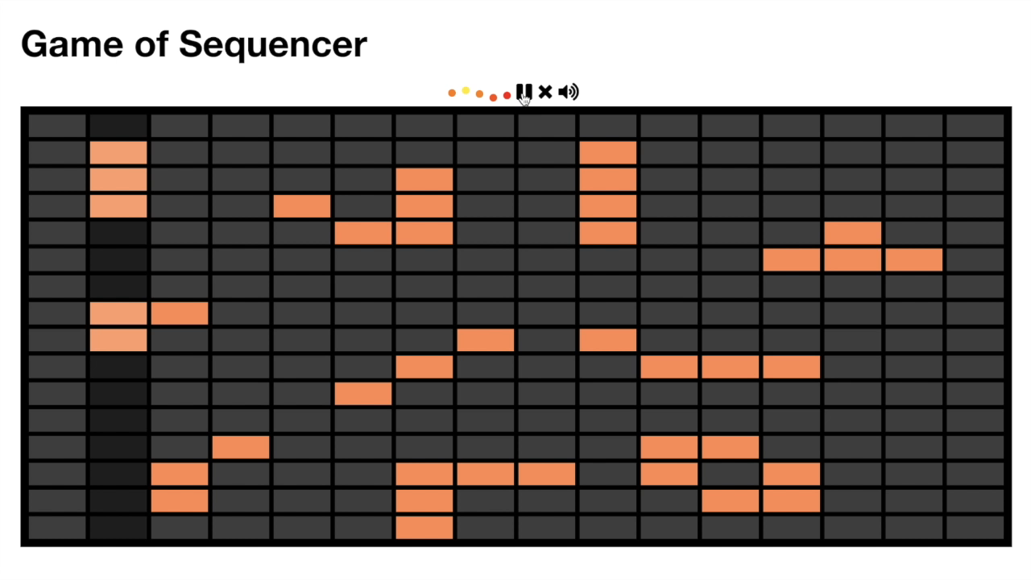
Game of Sequencer
Combine the Sequencer and life of game
generate notes by the rule of game of life

Slide 13
Game of Sequencer
It powerd by Web front end technology and web audio api
Some trick about notes
DEMO

Slide 14
Game of Sequencer
add store and share
add drum machine

